Slide 1

Homework
Line up
Christmas is coming, the famous American wholesale market (Costco) has gotten a long line before opening.
And we want to simulate the process of line up, but sometimes there are some people jumping in queue, join or leave the queue, it is not easier to implement it by a simply array.
Linked list
linked list is a linear collection of data elements whose order is not given by their physical placement in memory.
In its most basic form, each node contains: data, and a reference (in other words, a link) to the next node in the sequence.

Slide 2
Homework
Linked list
If we want to create a simple linked list, we need to create a structure which has the data we want to store and the pointer of this structure for storing the next reference.
In this homework, we only want to store every people’s ID, and how much money they have.
And you need to implement three function:
Join: we will give you a person’s information and you need to add him/her in your queue.
Input size : 2 number (ID, money)
Insert: we will give you a person’s information and the position he/she wants to insert,
Input size : 3 number (ID, money, position)
Leave: we will give you the position where someone want to leave.
Input size: 1 number (position)
Because this is a simple practice, you don’t need to consider the exception.

Slide 3
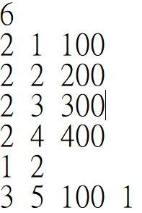
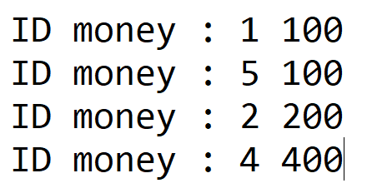
Homework
Input format:
First line is how many lines you will get, and then every line will have 2 ~ 4 numbers. The first number of every line is told you how many input you will get. The amount of inputs for different function, and the format will same as the function we introduce.
Output format:
After all of the operations, you need to output everyone’s information sequentially.

Slide 4
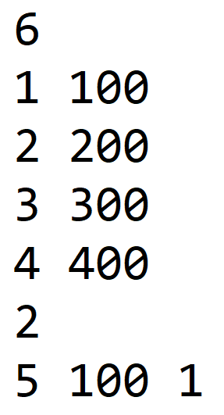
Homework
Input format(Bonus):
First line is how many lines you will get, and then every line will have 1 ~ 3 numbers. The amount of inputs for different function, and the format will same as the function we introduce.
If you can follow this input format, you will get some bonus in the homework.

